Slide 1
How Charts Work
Jeremy Morris
Department of Operations and Information Systems
University of Utah

Slide 2
How charts work
Charts are made up of two kinds of information
Scaffolding
Elements around the content that give the chart context
Content
How the data is encoded, the primary part of the chart we read and understand

Slide 3
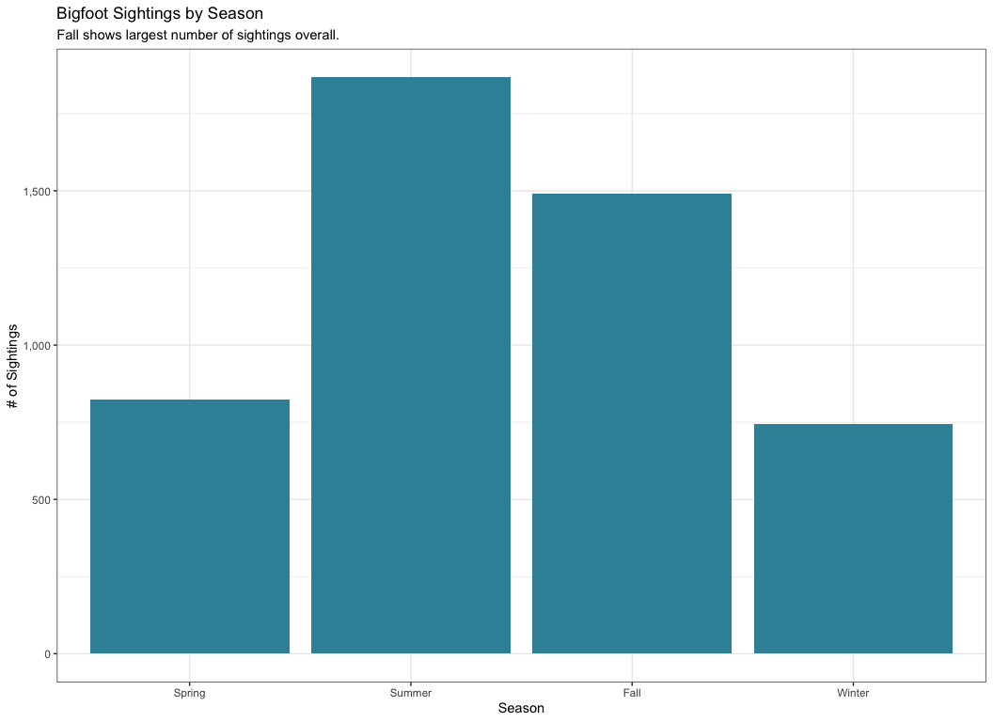
Consider the following chart

Slide 4
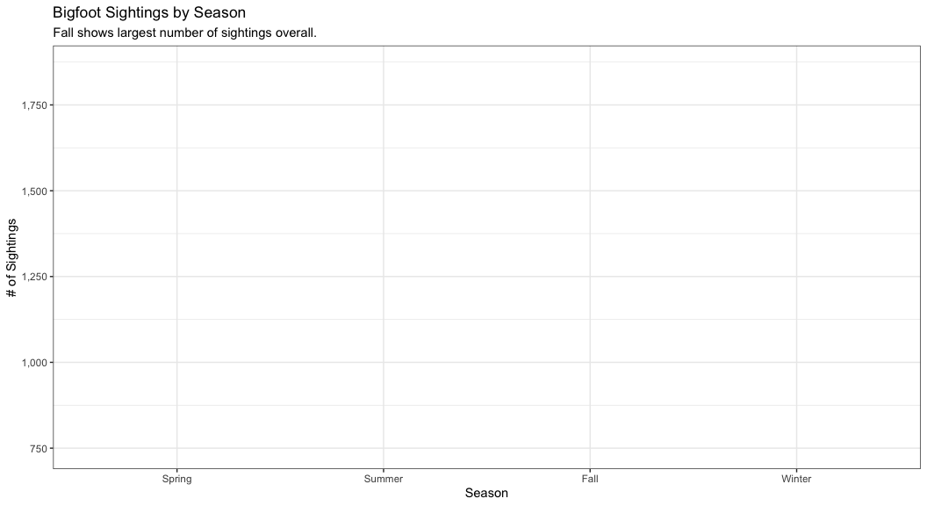
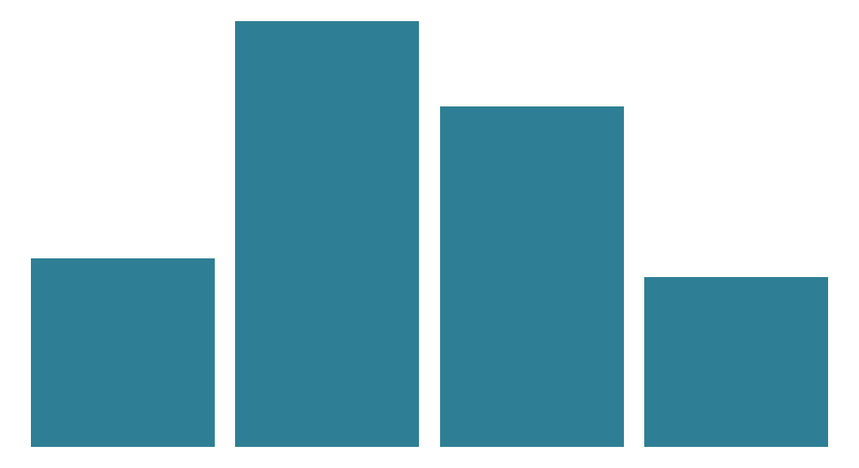
Scaffolding vs Content
Scaffolding
Content
Information around the chart
How the data is encoded

Slide 5
Data Encodings
Encoding is a way to convert one thing into another for purposes of communication.
Gestalt - method of organization that makes things more than a sum of its parts
Proximity
Similarity
Enclosure
Connection
Preattentive Attributes - visual properties we notice without using conscious effort
Line length
Size
Shape
Color
Position
Why is encoding necessary?

Slide 6
How is this data encoded?
# A tibble: 20 × 2 County `Median Income` <chr> <chr> 1 Alachua County $24,000 2 Baker County $32,000 3 Bay County $29,000 4 Bradford County $27,005 5 Brevard County $32,250 6 Broward County $33,140 7 Calhoun County $21,000 8 Charlotte County $30,000 9 Citrus County $25,400 10 Clay County $40,200 11 Collier County $39,900 12 Columbia County $24,860 13 De Soto County $25,000 14 Dixie County $20,010 15 Duval County $32,875 16 Escambia County $28,115 17 Flagler County $33,250 18 Franklin County $21,370 19 Gadsden County $25,000 20 Gilchrist County $25,000

Slide 7
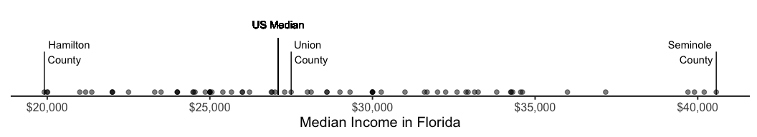
How is this different?
How is the data encoded?
What does it do better than the tables?

Slide 8
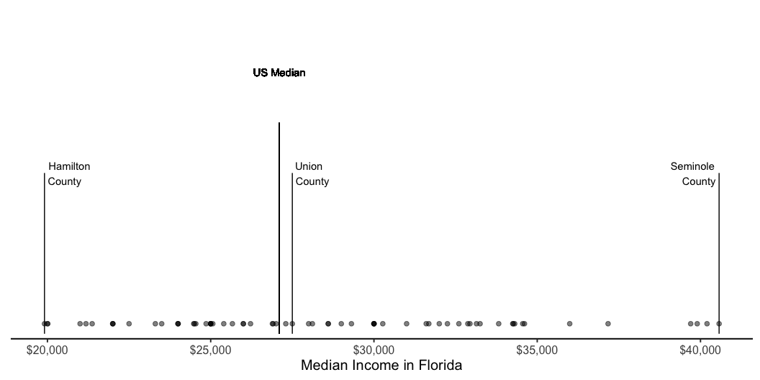
Compare Encodings
# A tibble: 20 × 2 County `Median Income` <chr> <chr> 1 Alachua County $24,000 2 Baker County $32,000 3 Bay County $29,000 4 Bradford County $27,005 5 Brevard County $32,250 6 Broward County $33,140 7 Calhoun County $21,000 8 Charlotte County $30,000 9 Citrus County $25,400 10 Clay County $40,200 11 Collier County $39,900 12 Columbia County $24,860 13 De Soto County $25,000 14 Dixie County $20,010 15 Duval County $32,875 16 Escambia County $28,115 17 Flagler County $33,250 18 Franklin County $21,370 19 Gadsden County $25,000 20 Gilchrist County $25,000

Slide 9
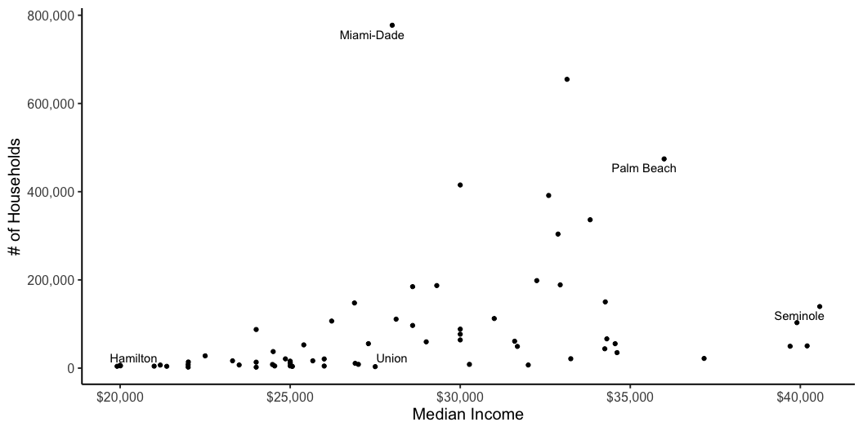
One more encoding example
What can we learn now that we have changed the encoding?

Slide 10
Choosing an effective visual
Jeremy Morris
Department of Operations and Information Systems
University of Utah

Slide 11
Introduction
80-20 rule:
A small subset of available visual displays can handle the majority of data visualization requirements

Slide 12
Verbal vs. Visual system
Verbal System
Visual displays: simple text and tables
Interacting with Verbal System == reading; therefore relatively slow in processing information
Visual System
Visual displays: points, bars and area
Interacting with Visual System is relatively fast in processing information
Navigate to: http://neomam.com/interactive/13reasons/
Discuss

Slide 13
Visual displays | practical subset
Verbal System
Simple text
Tables
Table
Heatmap
Visual System
Points
Scatterplot
Line graph
Slopegraph
Bars
Vertical bar
Stacked vertical bar
Waterfall
Horizontal bar
Stacked horizontal bar
Area
Square area
Other
Pies and Donuts
3D
Secondary axes

Slide 14
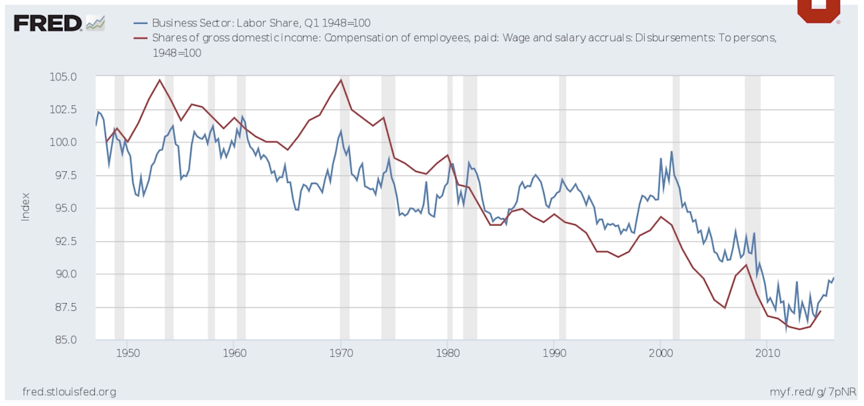
Often some verbal elements in charts

Slide 15
Simple text
One or two numbers to share
Number(s) should be prominent with a few supporting words
If a graph does little or nothing to aid in the interpretation, don’t use it
Considerations:
convert two numbers into a single number (only if important context is not lost)
20%
of children had a
traditional stay-at-home mom
in 2012, as compared to 41% in 1970

Slide 16
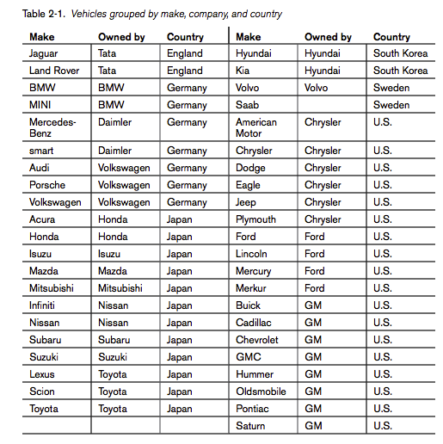
Table | Table
Used for reading across rows and down columns/comparing values
Good for:
mixed audience: each member can examine what they care about most
mixed scales: when data have mixed scales (e.g. age and income) some graphs can be challenging
Not good for:
Live presentations
Considerations:
Borders and shading should enhance the legibility of the table; remove/fade them accordingly
Notes:
Beautiful Visualization Edited by Julie Steele and Noah Iliinsky Copyright © 2010 O’Reilly Media, Inc. All rights reserved. Printed in Canada

Slide 17
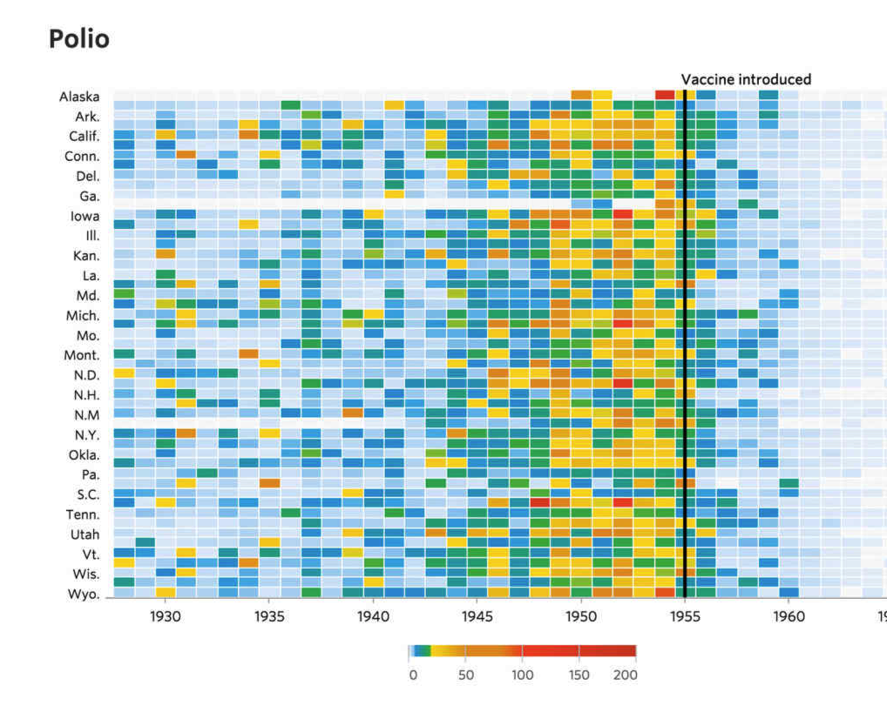
Table | Heatmap
Concept: benefits of a table using color/color saturation is visual cue to improve processing of information

Slide 18
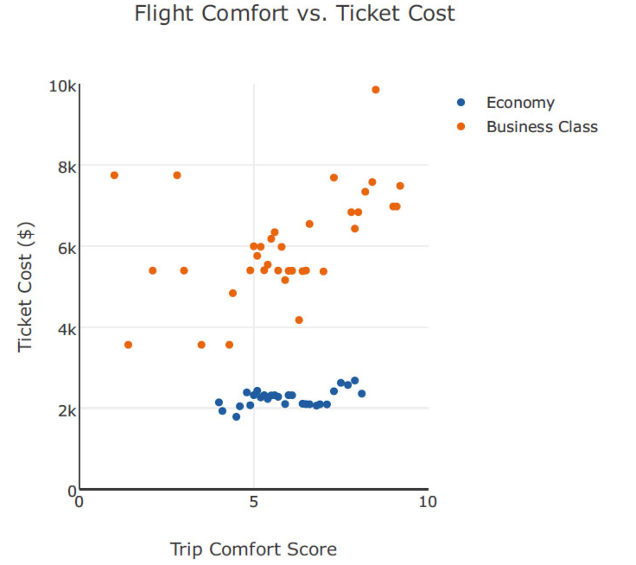
Points | Scatterplot
Useful for showing relationship between two variables

Slide 19
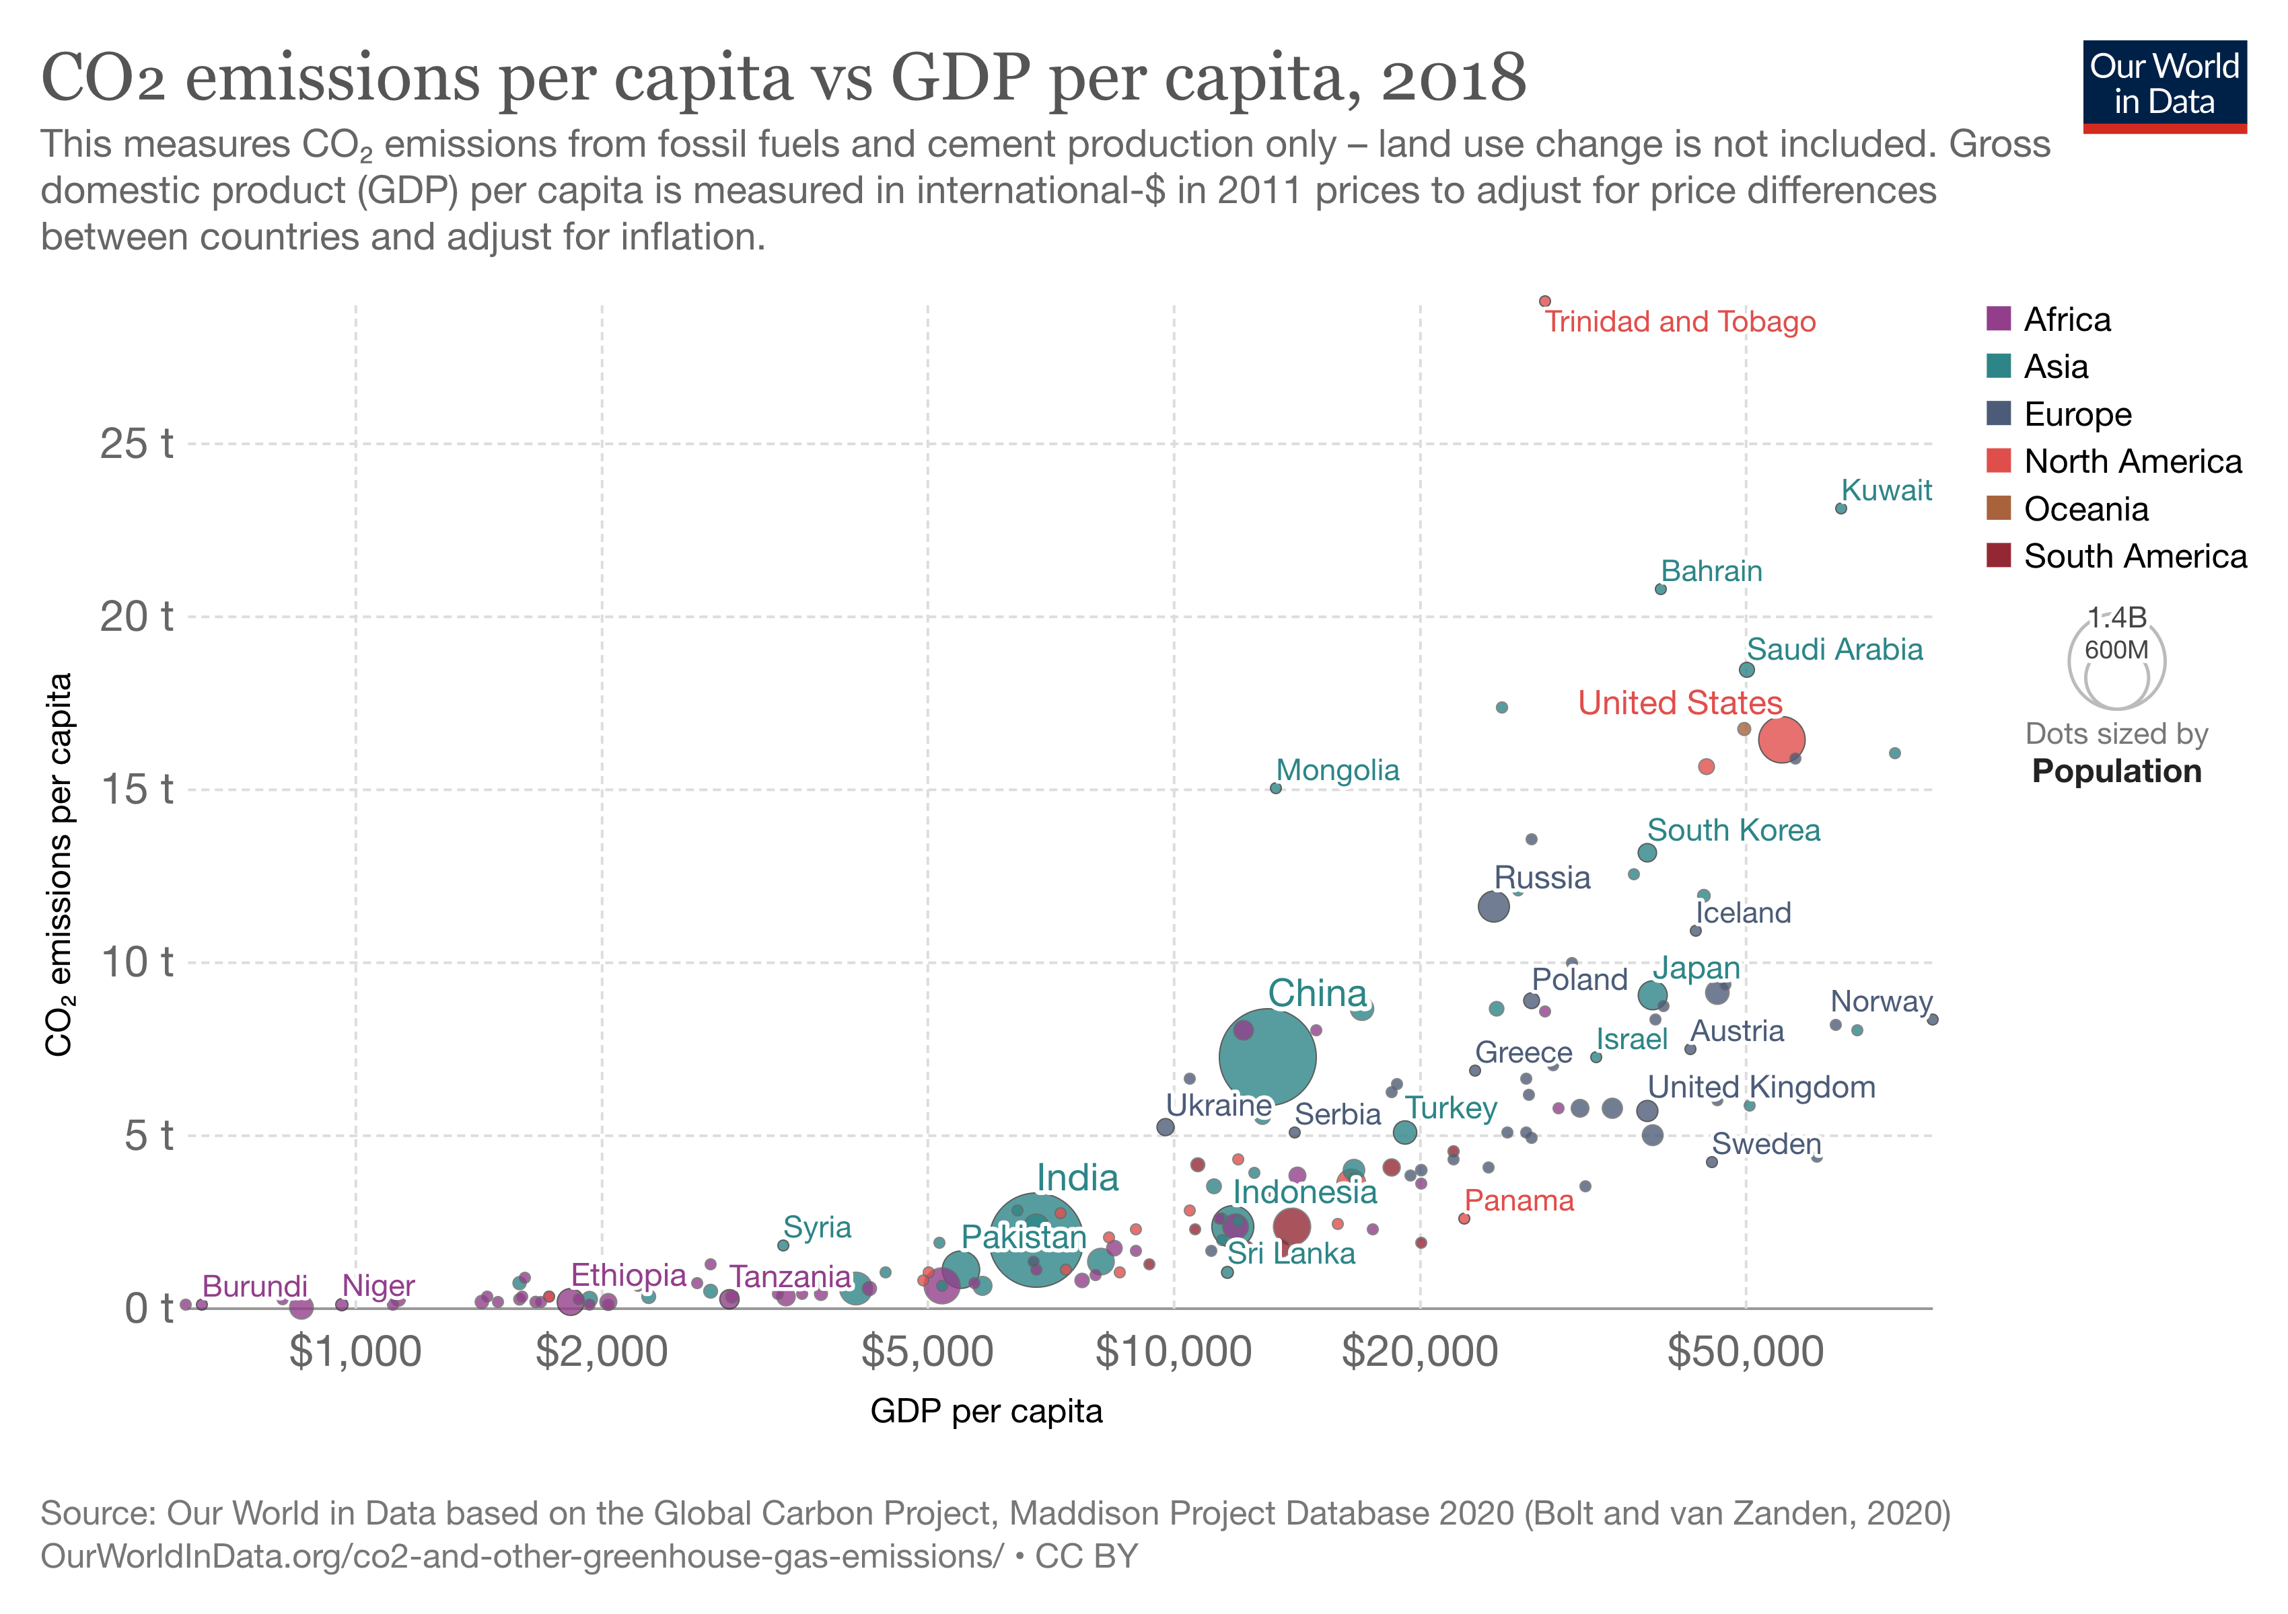
Bubble Chart
This is a scatterplot where the size of the bubbles are driven by data.
Great charts, but they pack in a lot of information.
What do you notice about the x-axis?

Slide 20
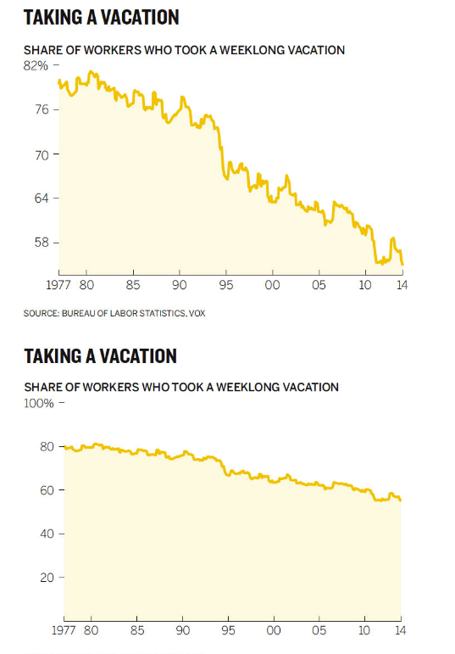
Points | Line graph
Useful for continuous (as opposed to categorical) data
Very common to connect data across time for several time periods
Considerations:
Number of series:
Single, two, more than two
Variance
Consistent time units on x-axis
Non-zero baseline is okay (due to relative comparisons)

Slide 21
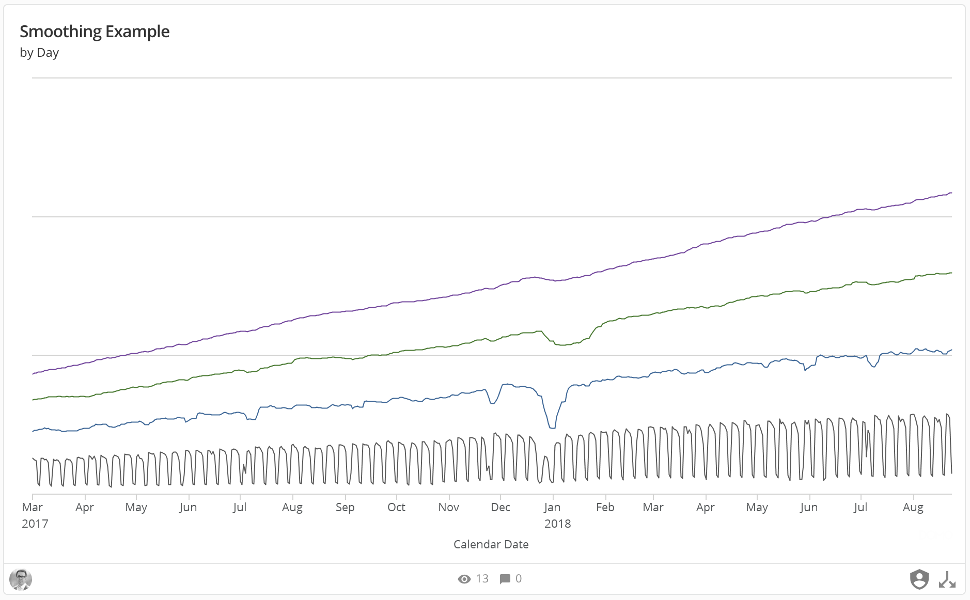

Slide 22
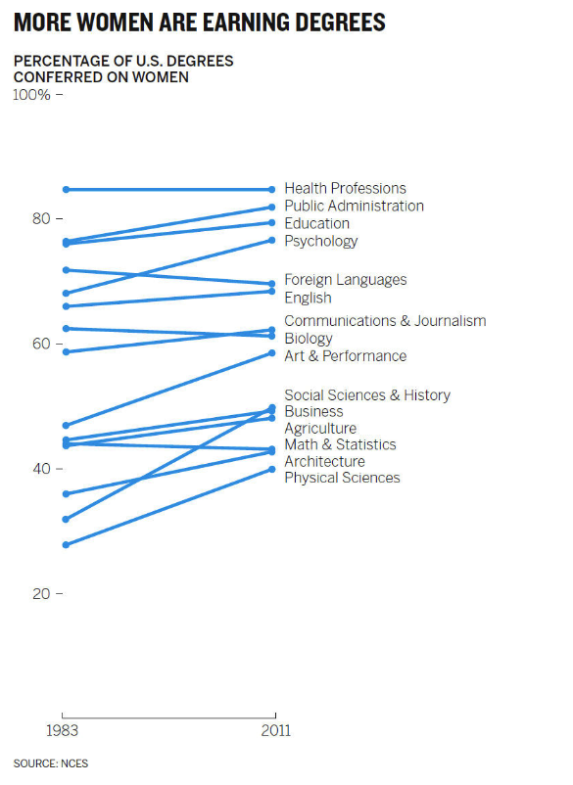
Points | Slopegraph
Useful for two time periods and multiple points of comparison
Can efficiently observe:
increase vs. decrease
relative rates of increase/decrease
absolute values

Slide 23
Bars | general
Concept: Bars sometimes avoided due to them being common
Consider using bars because the are common and will therefore have limited/no learning curve for the audience
Useful for categorical (as opposed to continuous) data
Can efficiently observe:
Largest/smallest value
Differences between categories
Considerations:
Y-axis on the left (as opposed to right based on how people read)
Zero baseline
Reduce redundant information (e.g. bar and axis labels)
Bar labels (detail) vs. axis labels (big picture)
Width of bars (Goldilocks concept: too thin, too thick, just right)
One, two and more than two series
Non-stacked (many use cases) vs. stacked (relative few use cases)
Stacked:
Absolute values vs. percentage of whole
Horizontal bar chart is very easy to read and produce
one reason: labels are on the y-axis

Slide 24
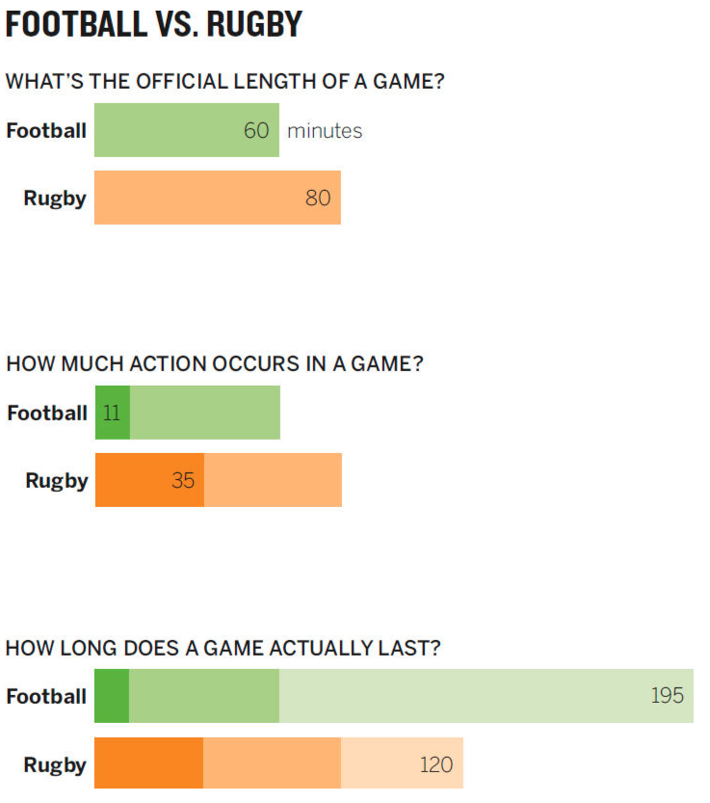
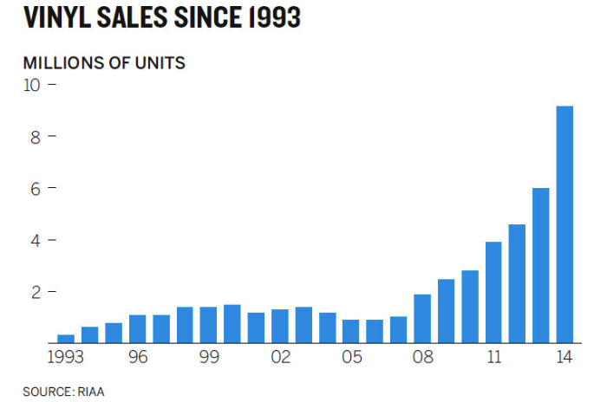
Bars | Vertical and horizonal bar

Slide 25
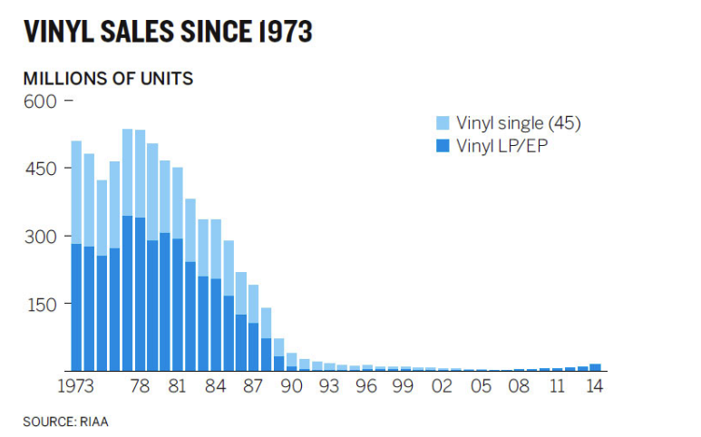
Bars | Stacked bar

Slide 26
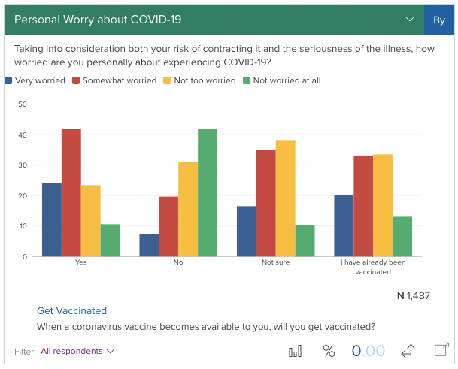
Bars | Grouped Bar
Issues
Often more complicated than they need to be
Generally speaking, you can make the same point with less data
Changing the chart type can make things clearer
Source: https://today.yougov.com/topics/politics/articles-reports/2021/04/09/half-vaccine-rejectors-believe-safe-travel-now

Slide 27
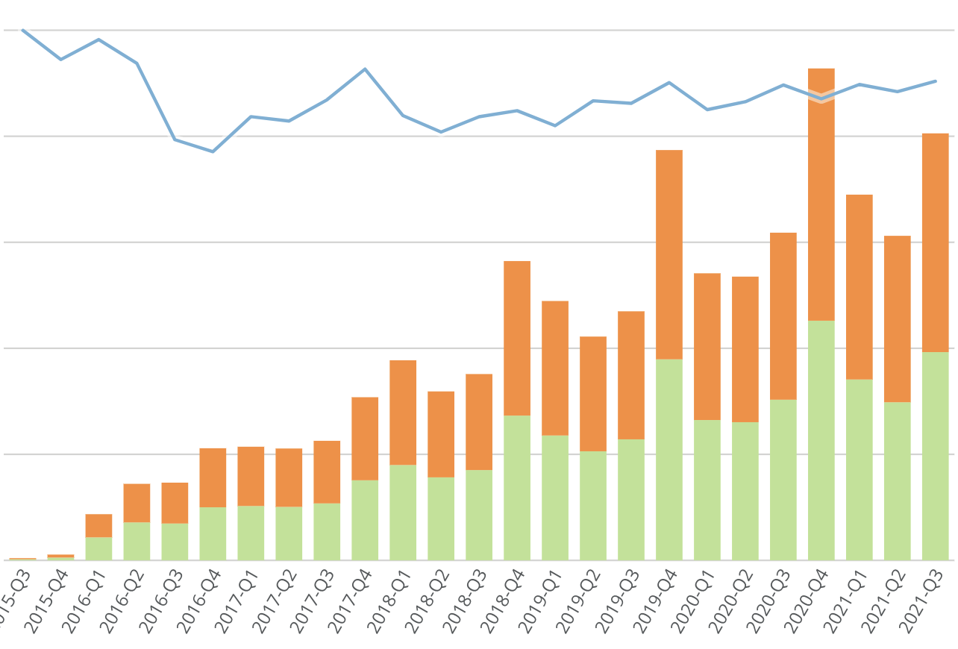
Bar Line Chart
Useful for:
Charting nominal values alongside percentages
Not good if
Displaying values of the same scale (can get confusing)
Some platforms don’t allow these to be created

Slide 28
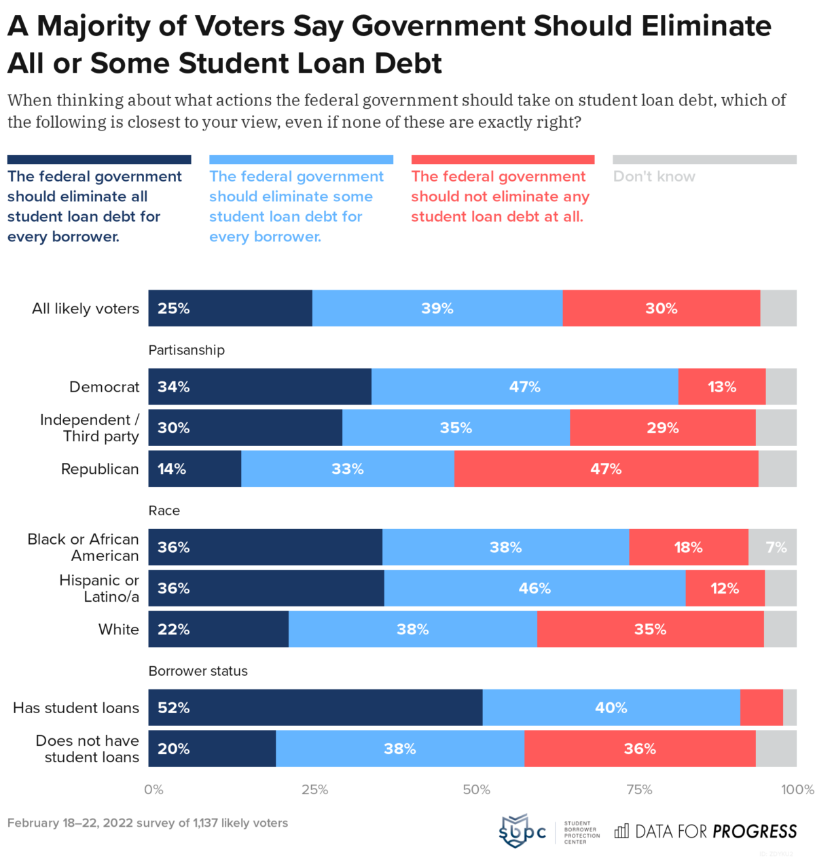
100% Stacked Bar Chart
This is a bar chart that converts all numbers to percentages.
All bars go the length/width of the chart.
Good for showing percent breakout.
Has some of the same issues as the standard stacked bar chart.

Slide 29
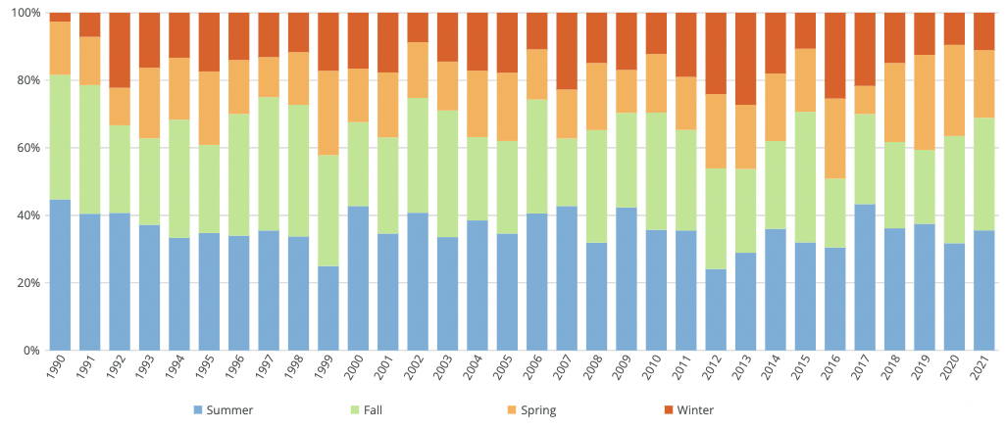
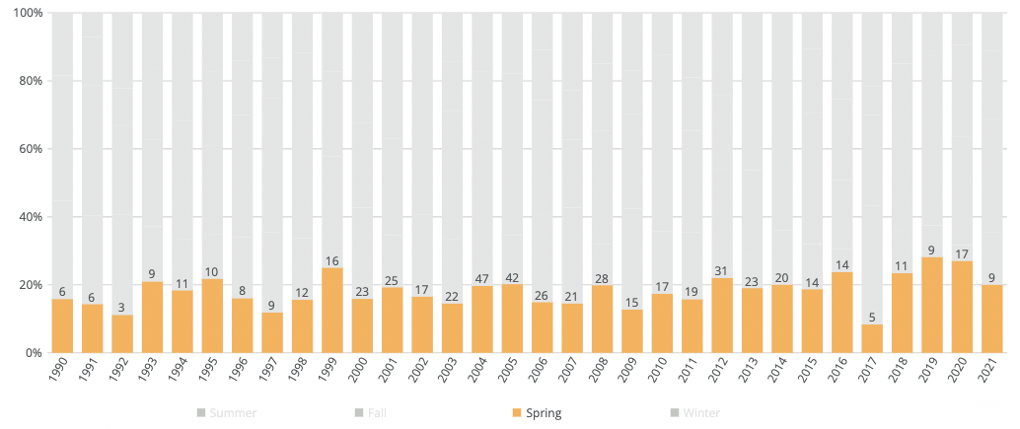
Interactivity can fix some issues

Slide 30
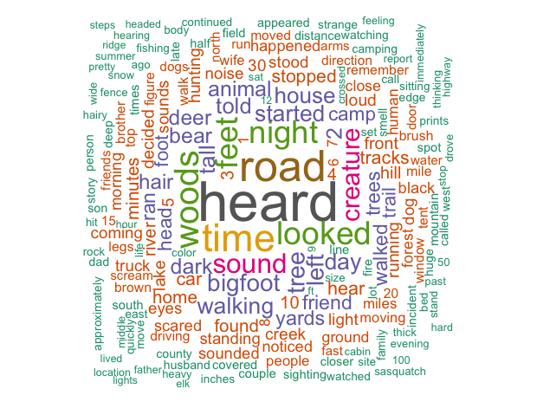
Wordcloud
Useful for:
Displaying word counts
Interesting and engaging way to look at counts of words
Not great:
At precision. This chart gives you a good idea of which words are most frequent but wordclouds are not great at comparisons.
It would be difficult to see the differences between two wordclouds

Slide 31
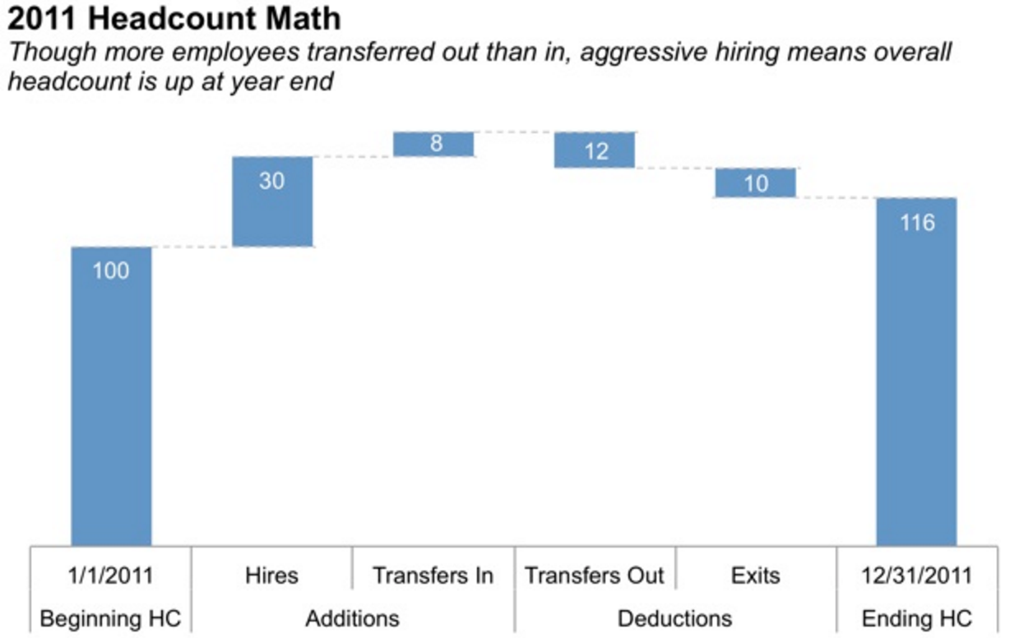
Bars | Waterfall
Useful for examining:
each part of stacked bar chart individually
or, showing a start point, multiple increases/decreases, then an end point

Slide 32
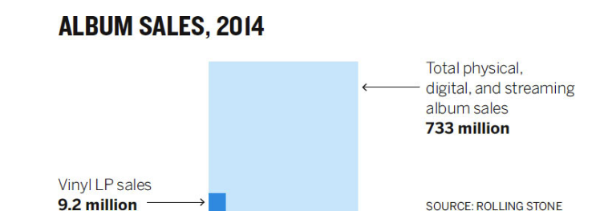
Area | Square area
Useful for visualizing numbers of vastly different magnitudes
Concept:
Squares provide two dimensions (height and width)
Bars just provide height or width)

Slide 33
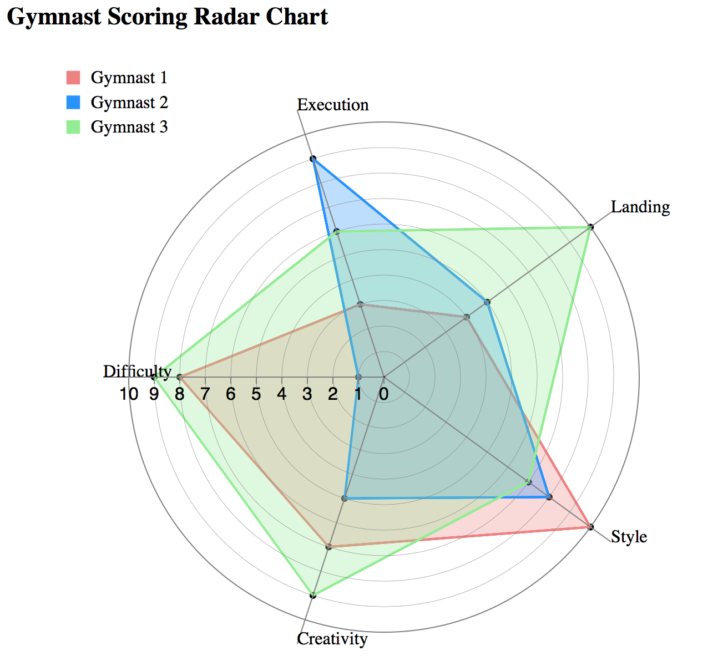
Radar Chart
Comparing a set of series on different measures
Concept:
Assume that each series should be the same
Any deviations will be clear

Slide 34
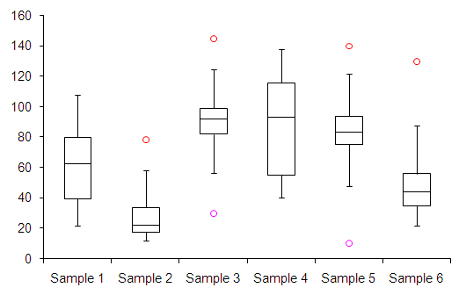
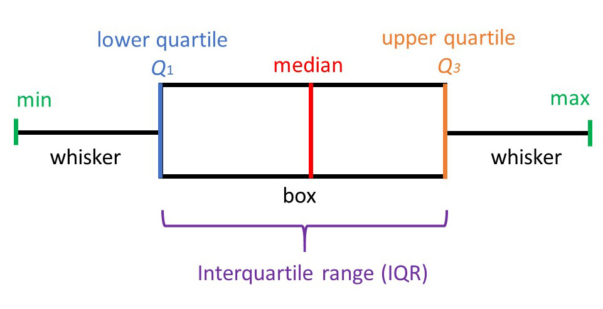
Boxplot
Summarize the distribution of a set of metrics
Concept:
Instead of showing a single summary metric, display a range of values
Used more for statistical analysis

Slide 35
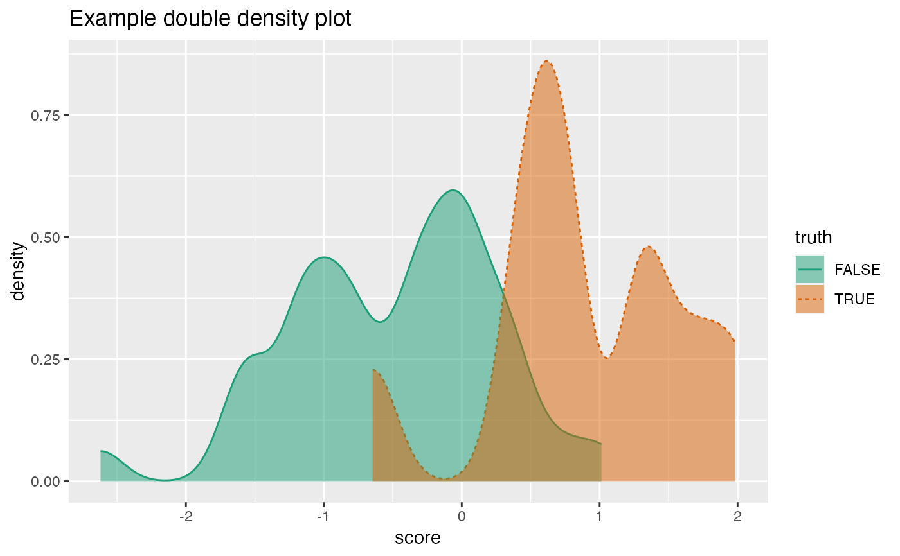
Density Plot
Summarize the distribution of one or more variables
Concept:
Smoothed version of a histogram
Often used in statistical analysis
Helps understand a variables distribution more than summary statistics

Slide 36
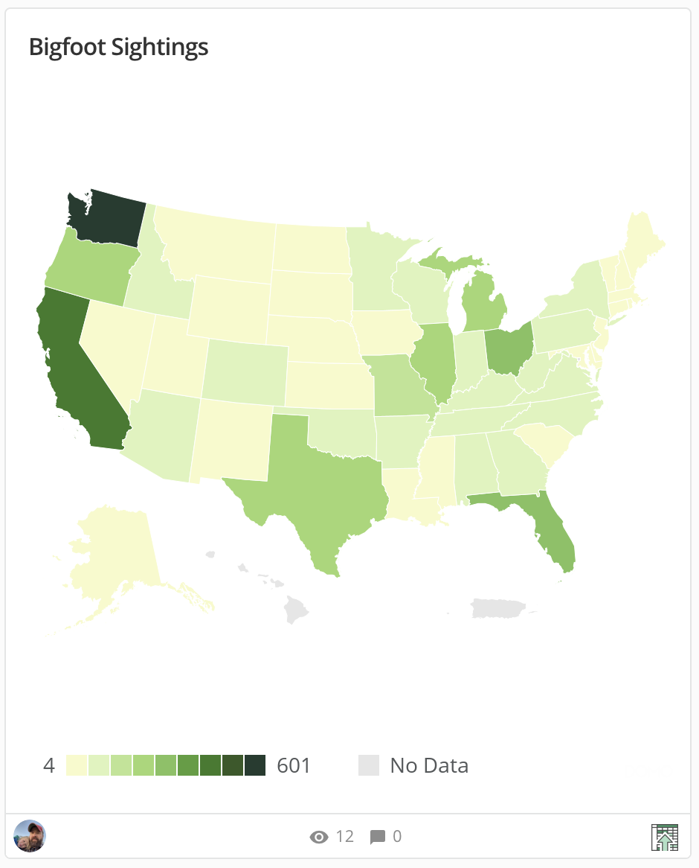
Maps
Good at:
Displaying data geographically
Can show distance in a way that is understandable
Regional distributions
Not good at:
Helps to have a working knowledge of the area
Precision, in many cases a bar chart will be better
Large differences can be tough to visualize

Slide 37
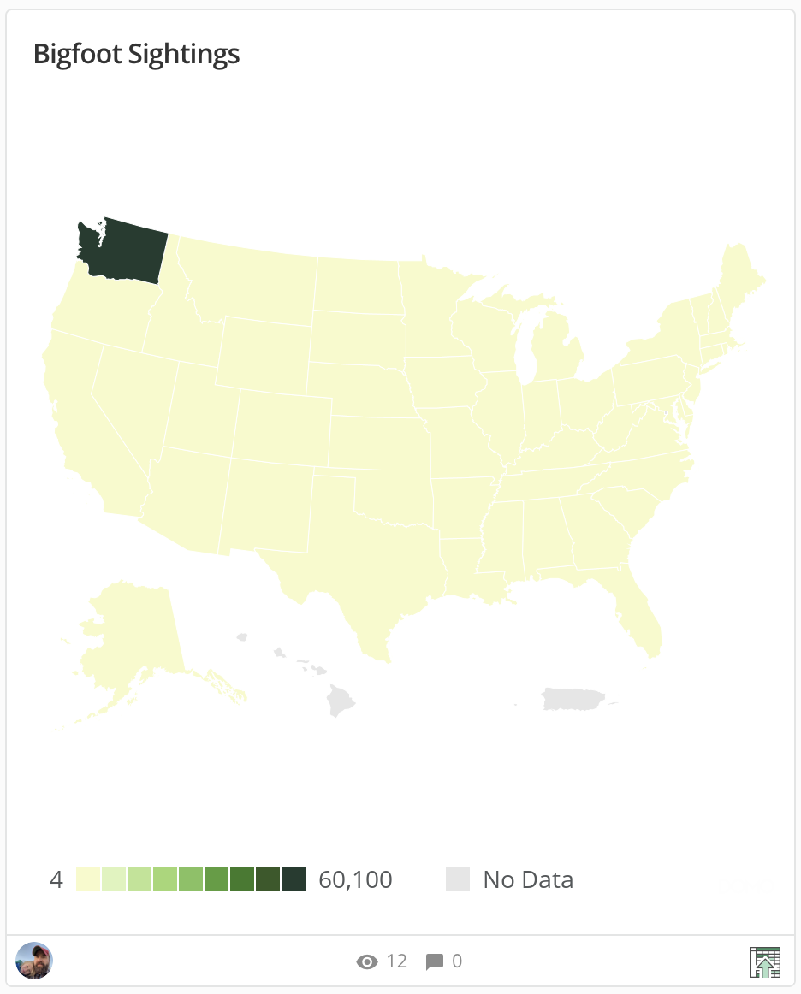
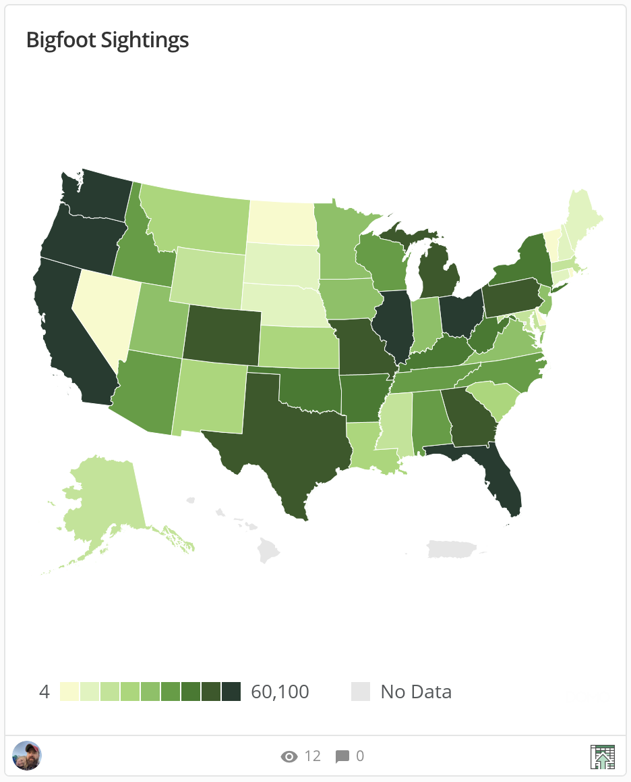
Map issues: large imbalances
Use a log scale for colors

Slide 38
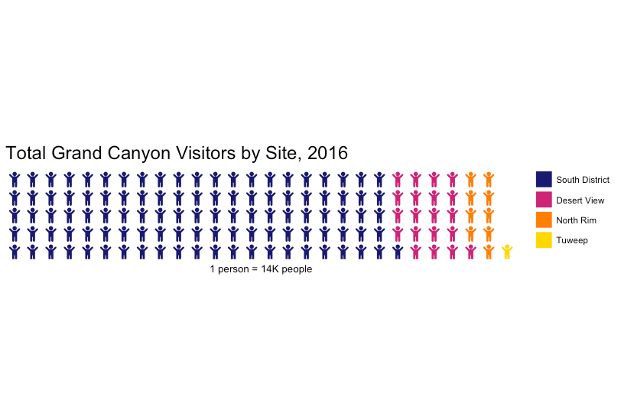
Waffle Plot
Interesting way to show percentages
Alternative to pie chart
Most will support some sort of image along with more generic squares

Slide 39
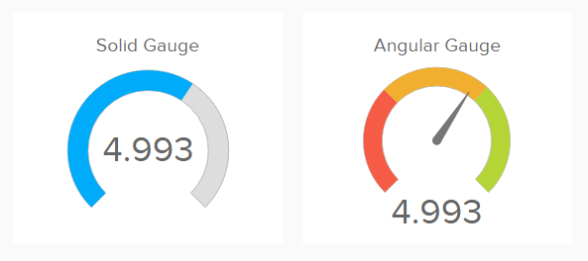
Gauges
Good for dashboards
Traffic lighting
Executive summaries
Not Pie charts

Slide 40
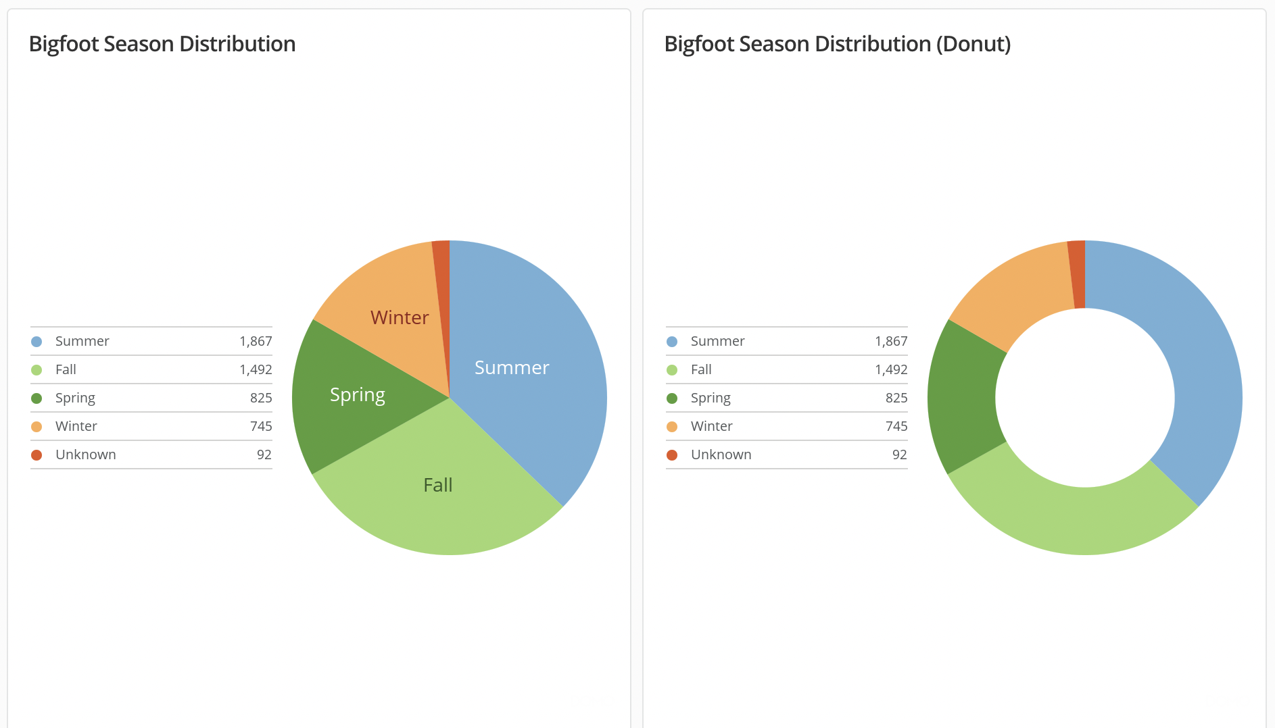
Pie and Donut Charts
Used for:
Showing percentages
Considered distributions
Lots of opinions about pie charts
Why???

Slide 41
What not to do | Pies and Donuts
Simply put, humans struggle to understand relative differences between circles as compared to rectangles

Slide 42
What not to do | Pies and Donuts
How many more times bigger?

Slide 43
What not to do | Pies and Donuts
How many more times bigger?

Slide 44
What not to do | Pies and Donuts
7x (in both cases)
https://www.youtube.com/watch?v=vc1bq0qIKoA, accessed 2016-06-27

Slide 45
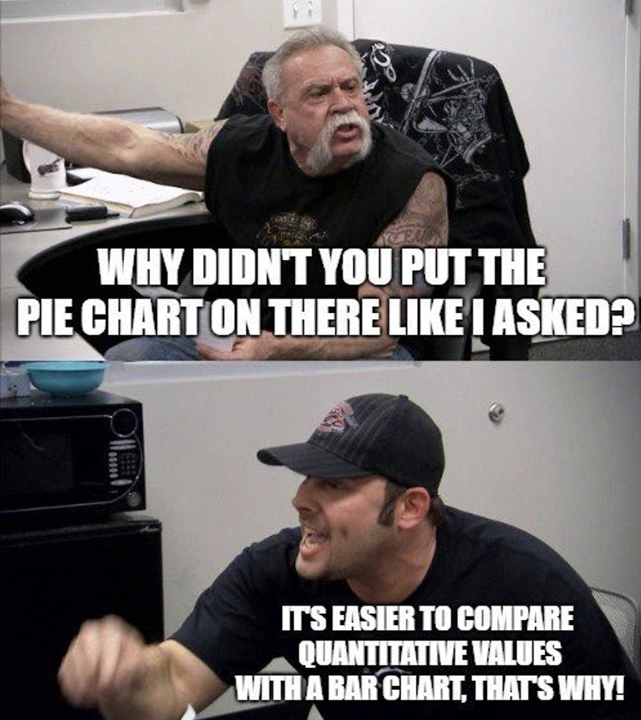
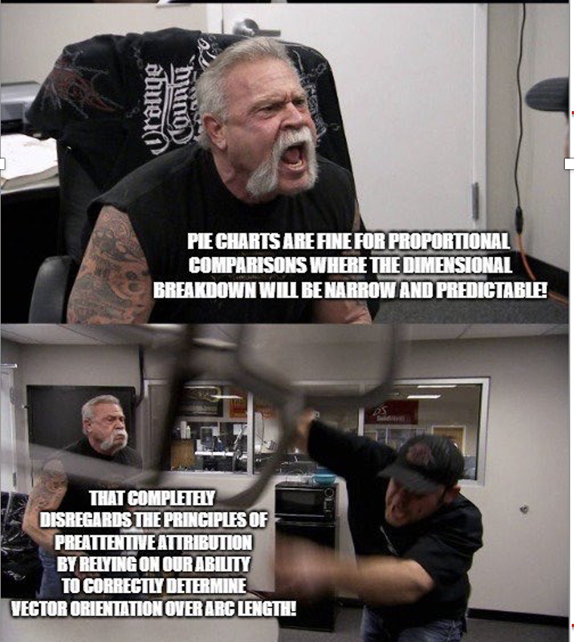
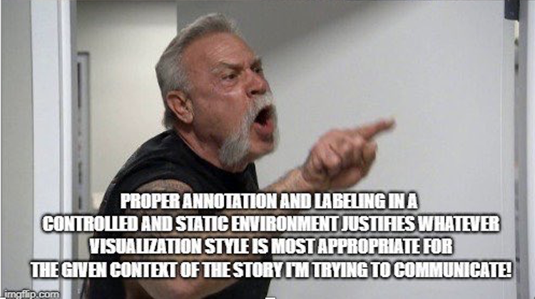
What not to do | Pies and Donuts

Slide 46
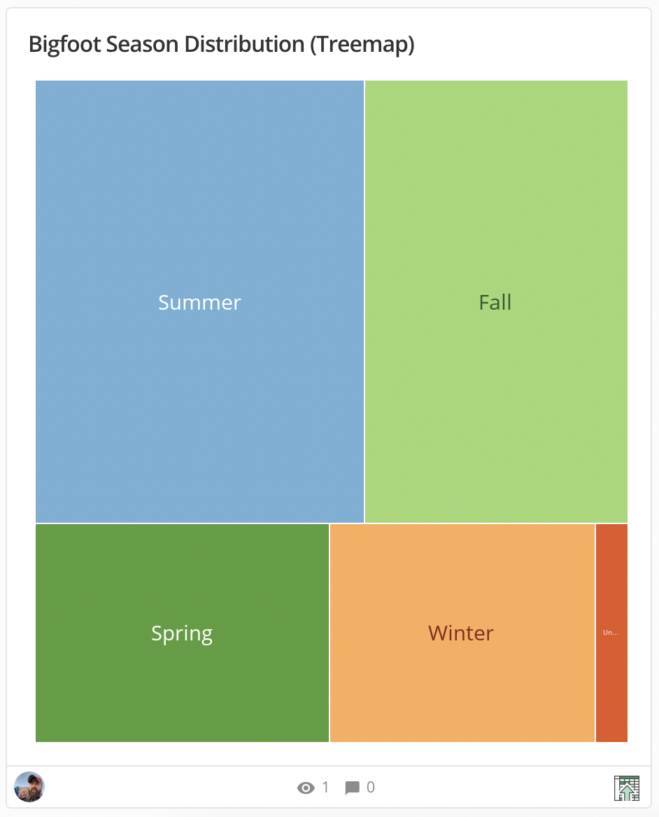
Treemap
What is it?
Alternative to pie chart
Displays proportions as boxes as opposed to slices of a circle
Avoids the issue with interpreting differences between angles
The problem?
Not as common and might require some explanation

Slide 47
Other | What not to do
3D – “never do it”
Unnecessary information to process
Secondary y-axis
Users may not interpret series based on the right-hand y-axis properly

Slide 48
How to fix charts

Slide 49
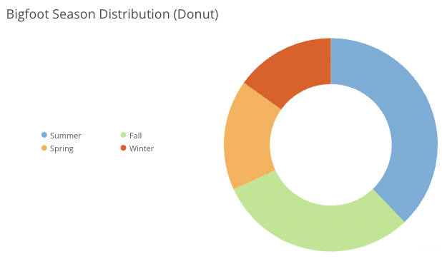
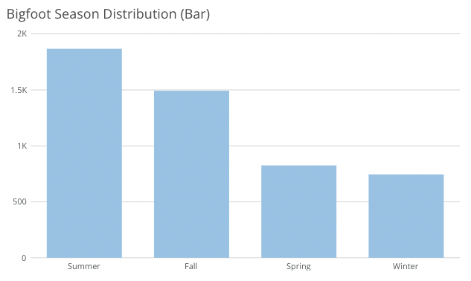
Changing chart types
Which has more sightings, Fall or Summer?

Slide 50
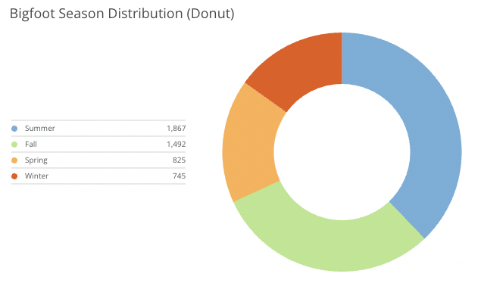
More than one way to fix it…

Slide 51
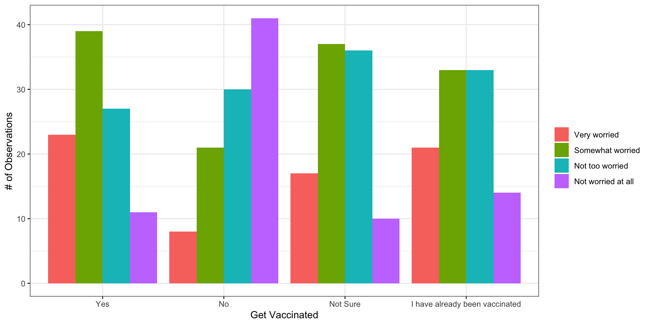
Grouped Bar Chart
Taking into consideration both your risk of contacting it and the seriousness of the illness, how worried are you personally about experiencing COVID-19?
How easy is it to tell what is going on with this chart?
Is the insight easy to see?
Source: https://today.yougov.com/topics/politics/articles-reports/2021/04/09/half-vaccine-rejectors-believe-safe-travel-now

Slide 52
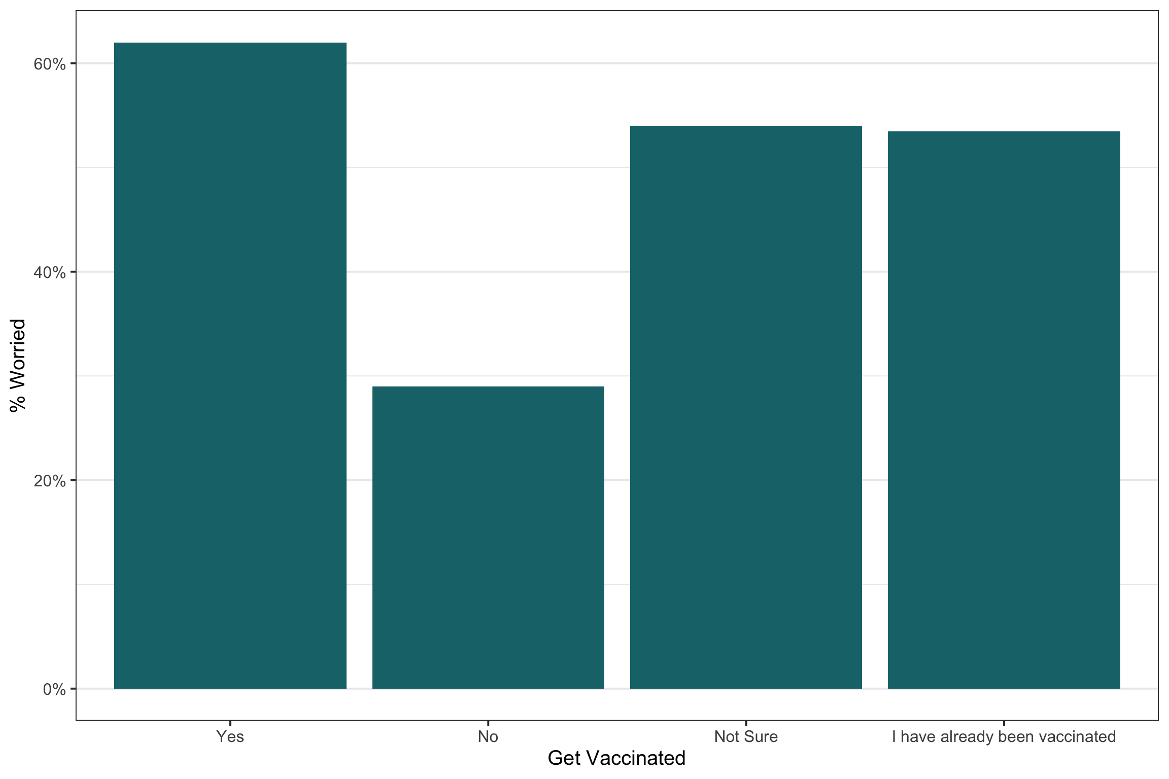
Chart only one of the percentages
Taking into consideration both your risk of contacting it and the seriousness of the illness, how worried are you personally about experiencing COVID-19?
Now only show the percent worried (could have also charted not worried)

Slide 53
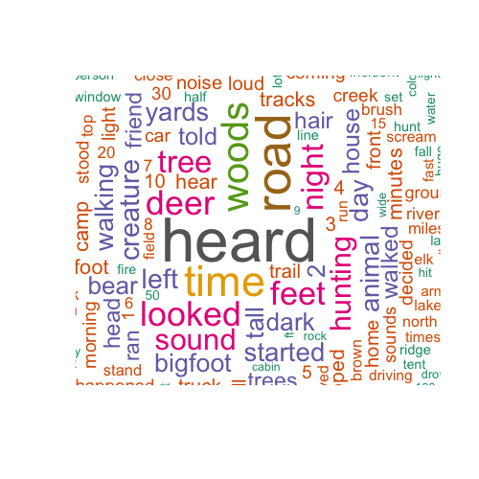
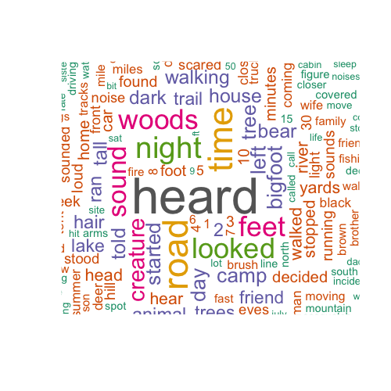
Wordcloud comparisons
Fall
Summer
How are sightings in the Fall different from sightings in the Summer?

Slide 54
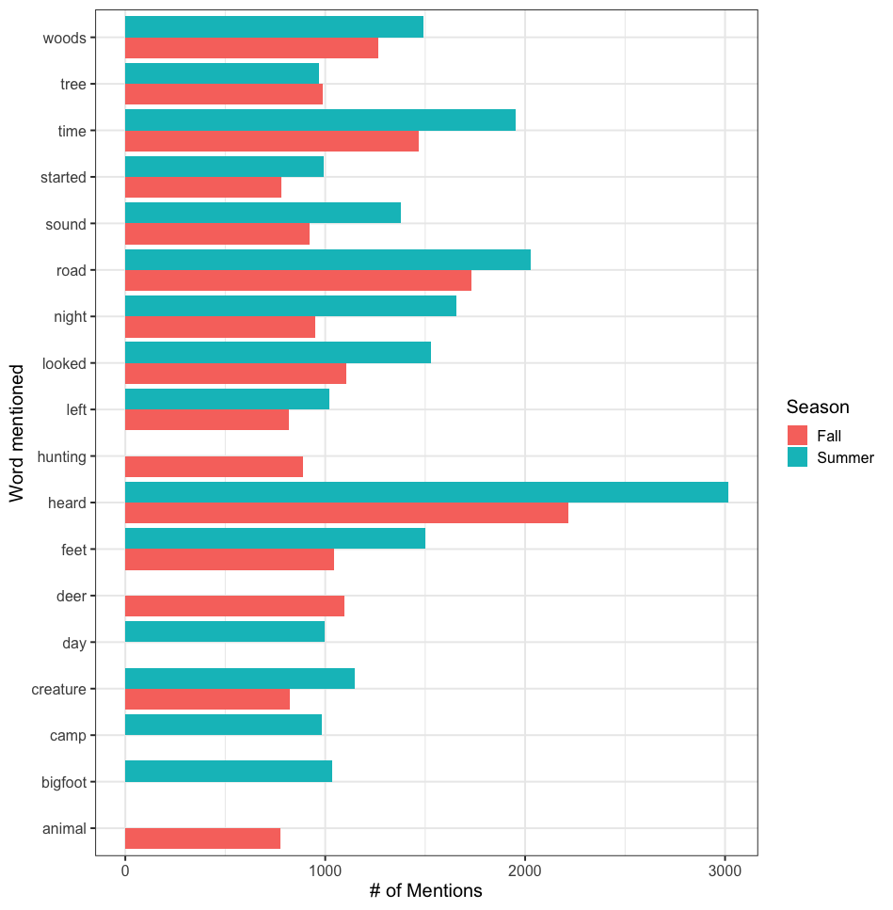
Switching to a bar chart can help
Now we can see which words show up more in one season than the other.
Is there a better way?

Slide 55
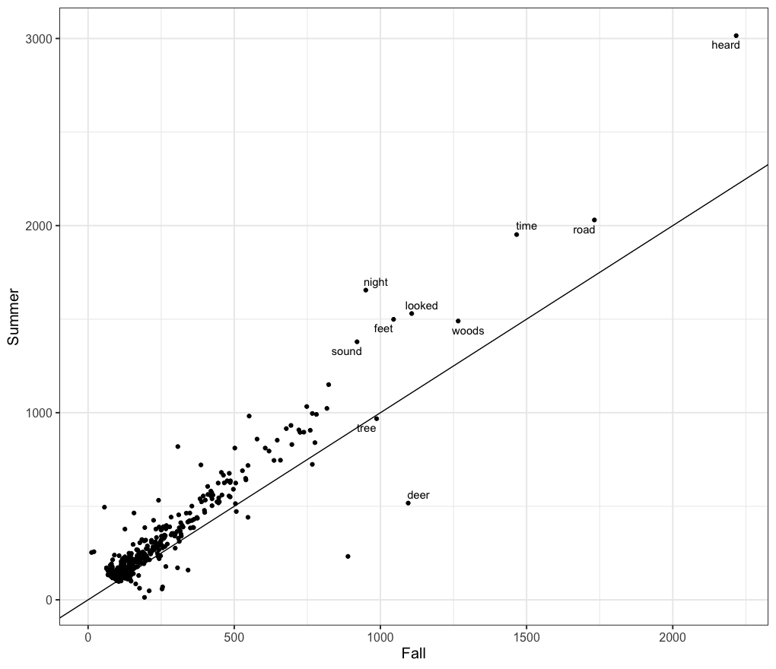
Try switching to a scatterplot
Now we have
numbers for Fall on the x-axis
Numbers for Summer on the y-axis
A line where y=x
A few words labeled
What is the problem?

Slide 56
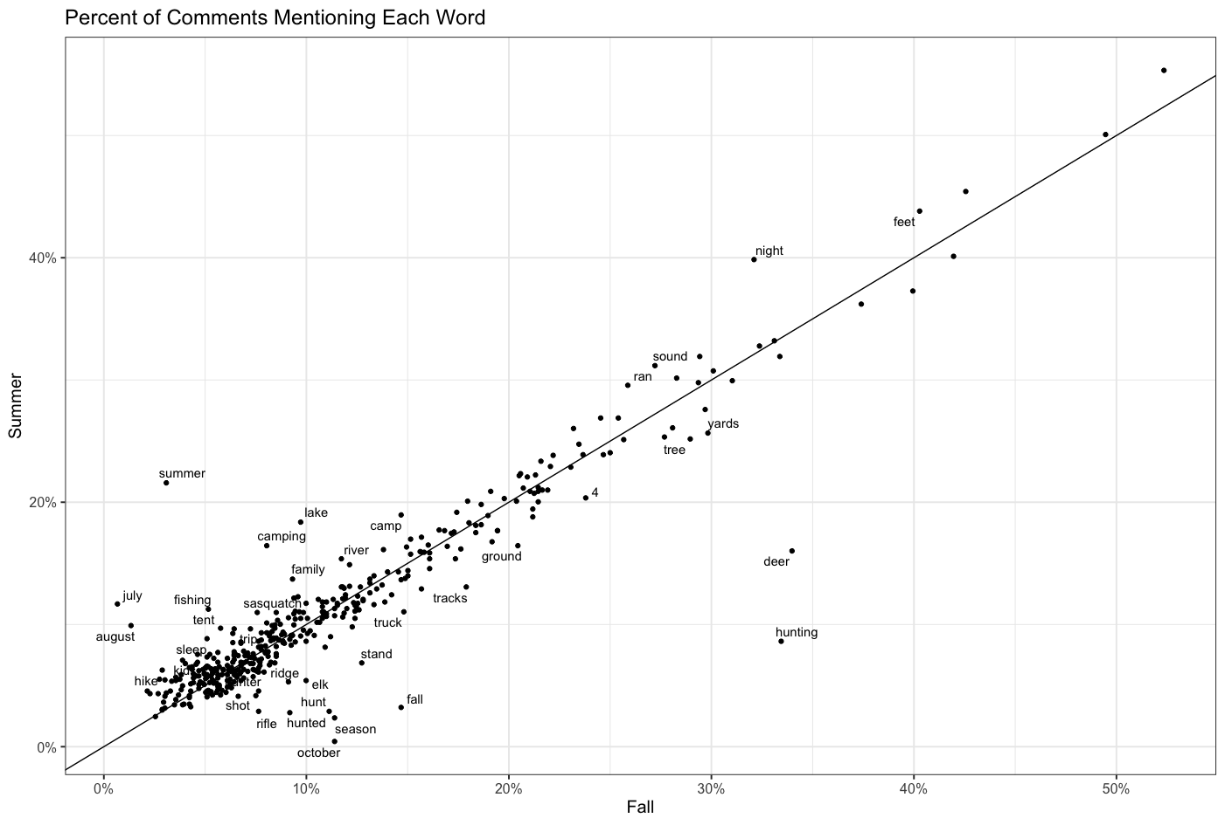
Change the variables
Now we look at the percent of sightings each word shows up in.
Interested in any large deviations.
Simpler than running regression models.

Slide 57
References
Nussbaumer Knaflic, C., “storytelling with data”, Wiley (2015)
Berinato, S., "Good Charts: The HBR Guide to Making Smarter, More Persuasive Data Visualizations", Harvard Business Review Press (2016)

Slide 58
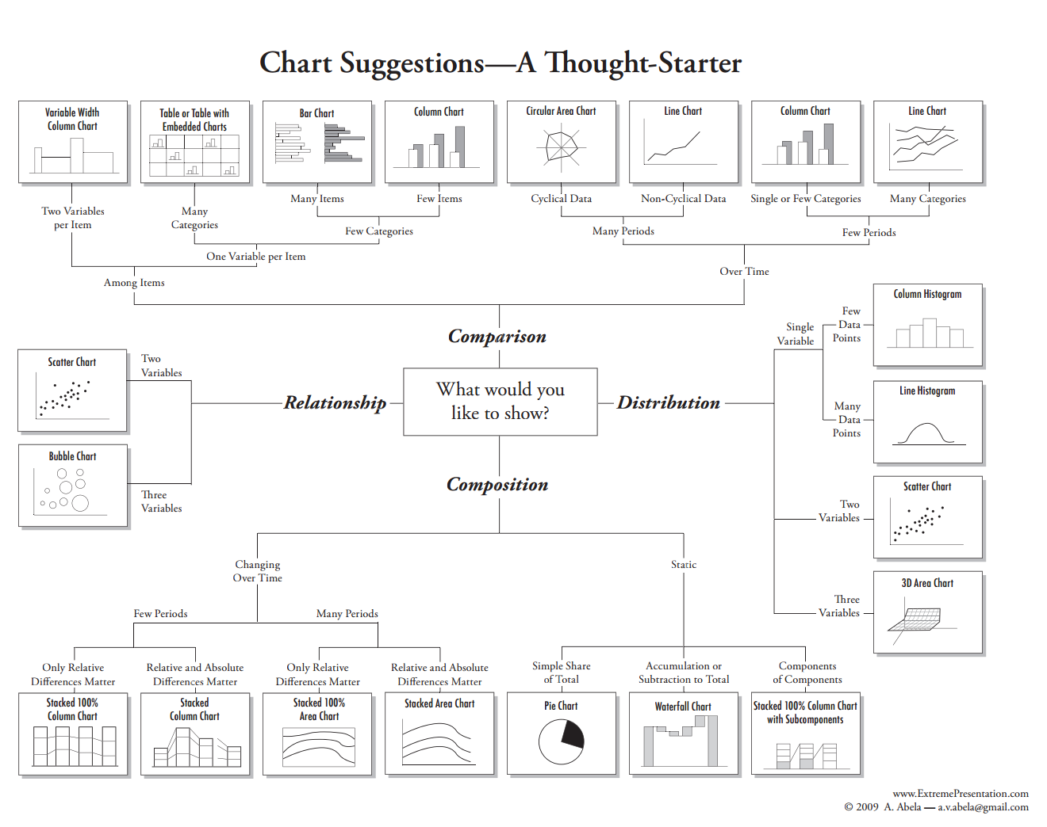
Compare Nussbaumer to Abela
* http://extremepresentation.typepad.com/blog/2006/09/choosing_a_good.html, accesed, 2016-06-20

Slide 59
Appendix

